Slide 1

G.H.RAISONI INSTITUTE OF
ENGINEERING & TECHNOLOGY
COMPUTER DEPARTMENT
BE PROJECT PHASE-2 EXAM PRESENTATION
S
TEAM MEMBERS:-
Shashank Naik
Ritu Mahajan
Yash Pattewar
Vrushti Patil
GUIDE : Asst .Prof Jyoti Chauhan
Notes:
From Here Shweta

Slide 2


PROJECT TITLE
Voice assistant for Restaurant Management System

Slide 3

Objective
The main objective of our project is to create a virtual waiter that will be able to serve the customers without breaking the social distancing rules.
To make the system as human as possible to provide comfort and provide impeccable customer service and satisfaction.

Slide 4
Problem Statement
Ever since the start of the Covid-19 pandemic, social distancing has become the new normal. We still need to maintain some rules and regulations to keep the pandemic under control. Restaurants and hotels are some of the major places where there is no other option but to interact with several people. This, however, increases the chances of transmission of the virus.
Keeping this in mind, we have introduced a solution to this problem with the help of our system GORDON-a personal waiter. It will be a voice assistant, which will work exactly like a normal human waiter. This will help us enjoy the services of hotels and cafes with maintaining social distance and thus taking care of our and others health.

Slide 5
Literature Survey
Author Name & Year​​ | Technique Used​​ | Merits ​​ | Demerits​​
[1]PO-SHENG CHIU1 , JIA-WEI CHANG 2 , MING-CHE LEE 3 , CHING-HUI CHEN3 , AND DA-SHENG LEE4​​ Received March 8, 2020.​​ ​​ | Deep neural network​​ | provided us the first step towards AI by generating a model based on how our own human body learns​​ | neural networks are also more computationally expensive​.
[2] Dongxu Yang ,Hua Wei ,Yun Zhu, Peijie Li, Jian-Cheng Tan ​​ Received March 2019.​​ | Cloud Computing​​ | Cloud Computing lets us deploy the service quickly | Network connectivity dependency. ​​
[3] Clément Delgrange,Jean-Michel Dussoux,Peter Ford Dominey ​​ Received March 2020.​​ | Natural Language Processing​​ | NLP also helps in identifying the discourse structure of connected text. | separate version of the product for each language​​
[4] S Sankar, p srinivasan 2018​​ | Fuzzy logic​​ | Calculating the quality of parent node among its preferred parent node using fuzzy logic​​ | Fuzzy logic is not Accurate and rigorous.​​

Slide 6
Hardware Requirements
Python-Due to the simplicity and availability of wide range of libraries we chose python as our primary language. Removal of errors is much easier with python interpreter thus making the process of development easy.
XAMPP- For database connectivity
Internet – For cloud connectivity
Software Requirements
Raspberry pi 3B+
USB Microphone and Speakers
SD card 32GB
Card Reader
HDMI Cable
5V Power Adapter

Slide 7

What will Gordon do?
The machine will be designed to act just like a waiter in the most humanly way possible.
It will greet the customers as they enter. It will provide the specials and highlights of the menu.
It will be designed to work just as a usual waiter would.
At the same time Gordon will be able to provide the customers with the bill and overlook the payments
It would play an important role in guest satisfaction as it will also be responsible for checking on customers to ensure that they are enjoying their meals and take the appropriate actions to correct any problems.

Slide 8
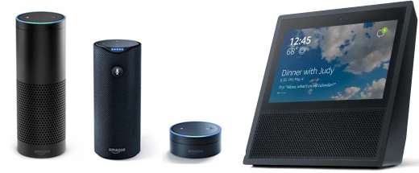


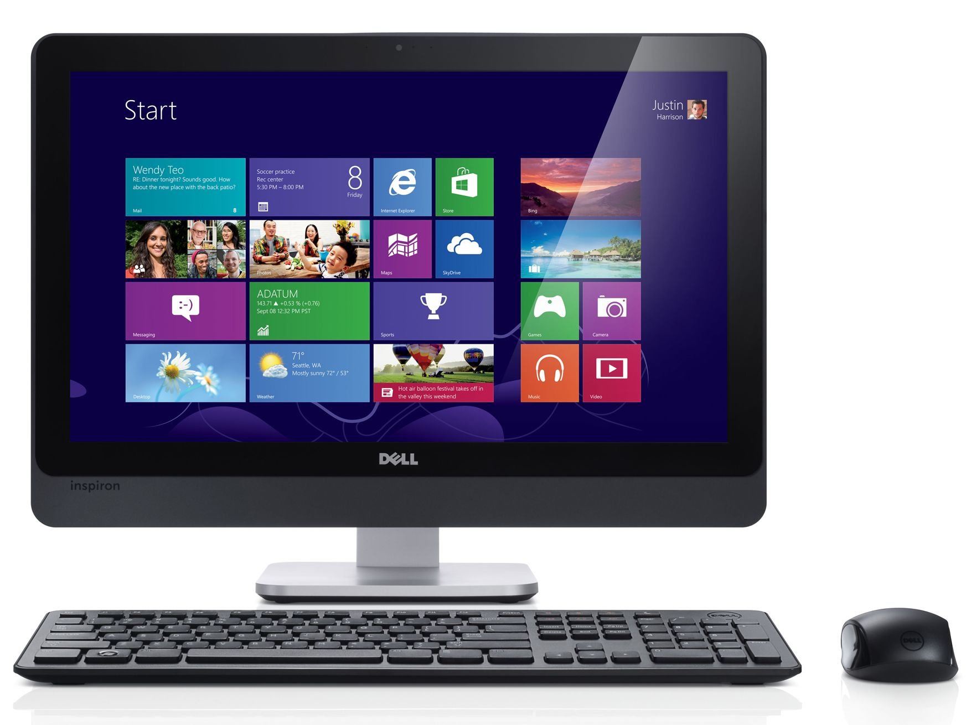
request
INTERACTION ENTITY
USER COMMANDS
response
response
CLOUD OR ON-PREMISES ENTITY
USER
Look up for the function or logic to be executed based on request and send output of the back-end process as response
BACK-END ENTITY

Slide 9
Methodology
1. Speech Recognition—This is a library which is used to perform speech recognition with Google Speech Recognition API .Google speech recognition api is one of the best API’s available. It was used for speech to text conversion in our program.
2. gTTS—This library is used to generate an mp3 file from Spoken text using Google Text-To-Speech (TTS) API. The output speech was produced using gTTS library and text can be converted to speech using google text to speech [2].
3. PyAudio is a set of Python bindings for PortAudio, a cross-platform C++ library interfacing with audio drivers.

Slide 10
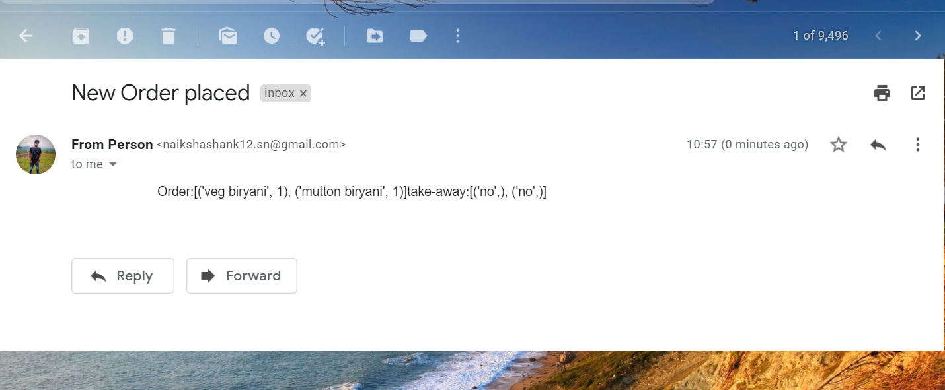
Libraries imported
Smtplib- Python provides smtplib module, which defines an SMTP client session object that can be used to send mail to any Internet machine with an SMTP or ESMTP. We have used this module to send order received to the kitchen or chef. An Email will be send with order details once the order is confirmed.

Slide 11
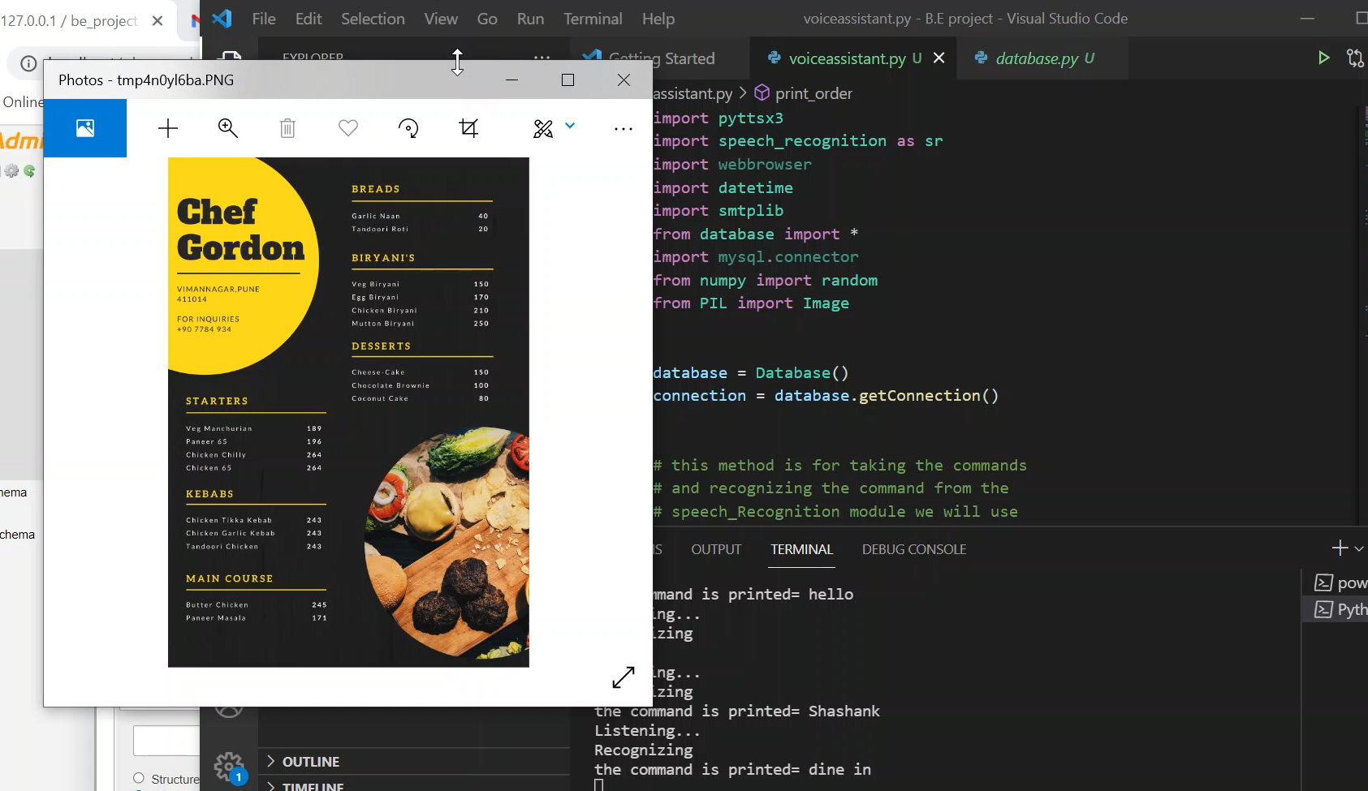
PIL(Python Imaging Library)- Python Imaging Library is a free and open-source additional library for the Python programming language that adds support for opening, manipulating, and saving many different image file formats. We have used it to open menu card on the screen while placing order.

Slide 12
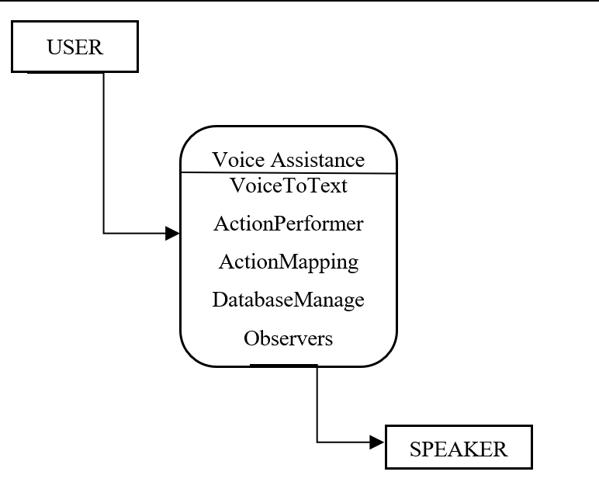
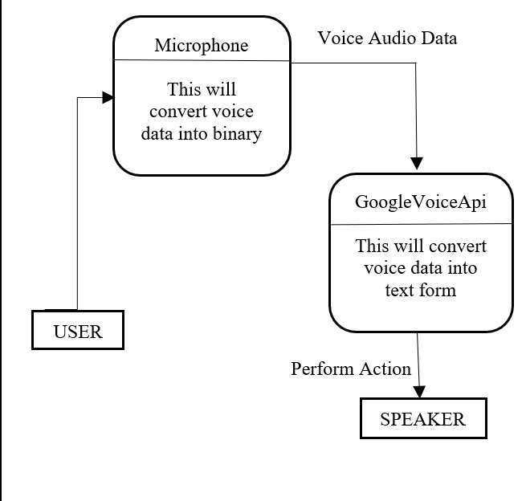
Data flow diagram

Slide 13
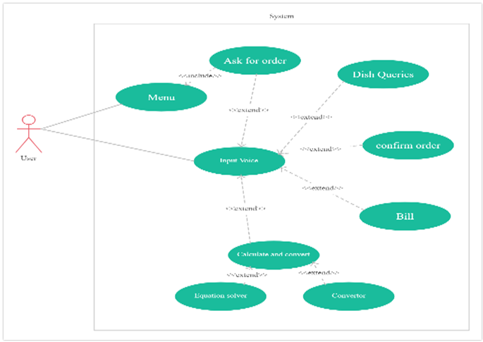
Use Case Diagram

Slide 14
Results and Discussion
Discussion: In the wake of the corona virus, many businesses have been affected. Sales have been dropped at the same time the risk of being affected comes to mind. Small businesses have been affected the most. At the same time food and hospitality industries have suffered tremendously. It is also said that the hospitality sector would be the last to recover from the virus as a lot of things need to be considered. Restaurants and hotels are places were a lot of people are gathered so the risk of being infected are relatively high.
Result: As a result, we have proposed the method of using voice assistant based waiter, named GORDON, in restaurants. The people can hence be able to place their orders and perform transactions reducing the interactions with people.

Slide 15
Future Scope
Can add different languages, so that people can order in their respective native language.
Will be adding online payment option.
Can increase various accents so that more people will be comfortable while ordering.
Can have male/female voice, which ever they are comfortable with.

Slide 16
Potential impact
Will reduce Covid cases by maintaining social distancing.
Will save customer time.
Will give deep detail about items.
Will reduce human error.

Slide 17
Conclusion
In conclusion, we will be able to provide excellent customer service and satisfaction while considering to all relevant health department rules/regulations and all customer service guidelines.

Slide 18
References
[1]“Next Generation of Virtual Personal Assistants” by Veton Kёpuska and Gamal Bohouta, Electrical and Computer Engineering Department, Florida Institute of Technology.
[2]“Voice Control Device using Raspberry Pi” by Pooja Singh, Pinki Nayak, Arpita Datta, Depanshu Sani, Garima Raghav and Rahul Tejpal, Department of Computer Science and I.T., Amity School of Engineering and Technology
[3]“A Study in Speech Recognition Control for a Surgical robot” by Kateryna Zinchenko, Chien-Yu.
[4]“Speech interface reformations and voice assistant personification preferences of children and parents” by Ye Yuan, Stryker Thompson
[5]“Communicative and social consequences of interactions with voice assistants” by Sara Aeschlimann, Marco Bleiker, Michael Wechner.

Slide 19
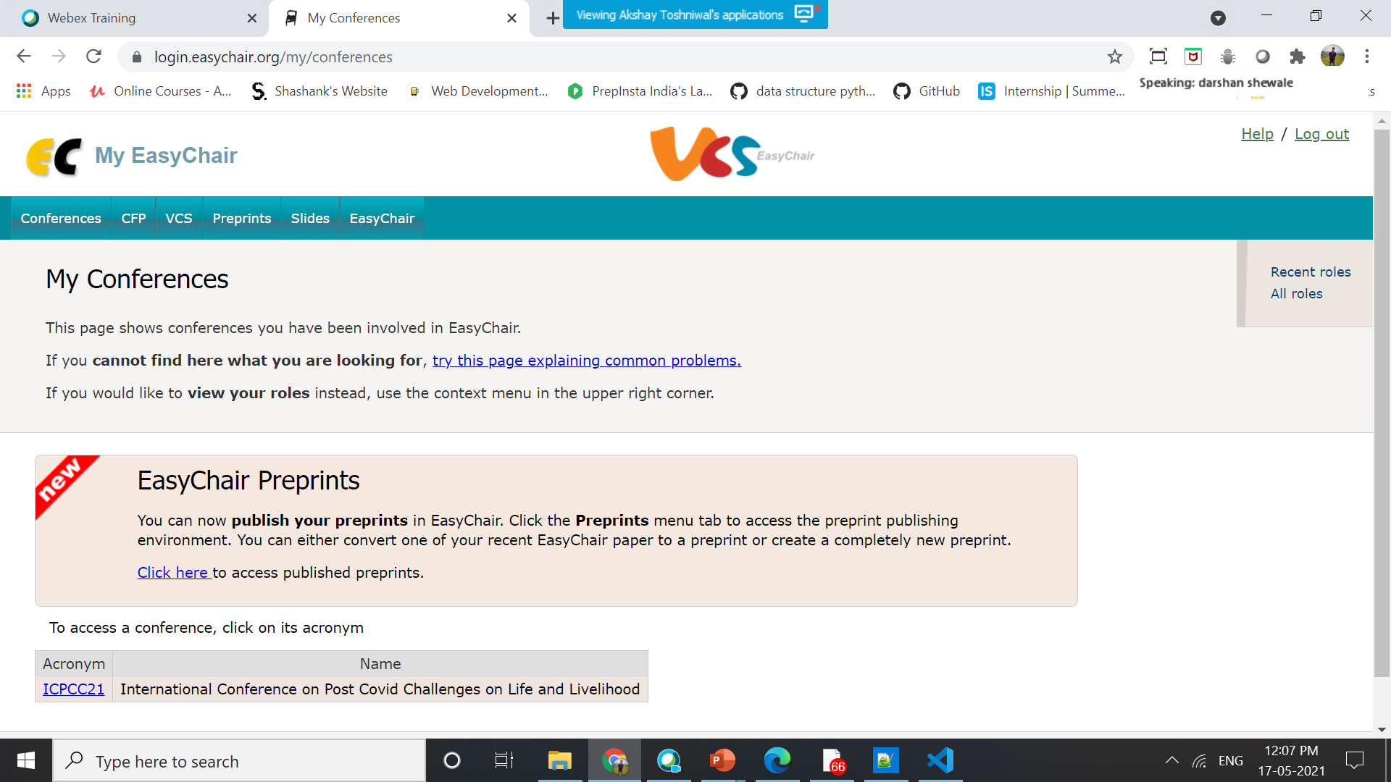
Paper Submission Status Phase-1
We have approached an international conference ICPCC-2021: International Conference on Post Covid challenges on Life and livelihood. We have also submitted the paper for publishing. Paper was accepted by conference on 16th Feb 2021.

Slide 20
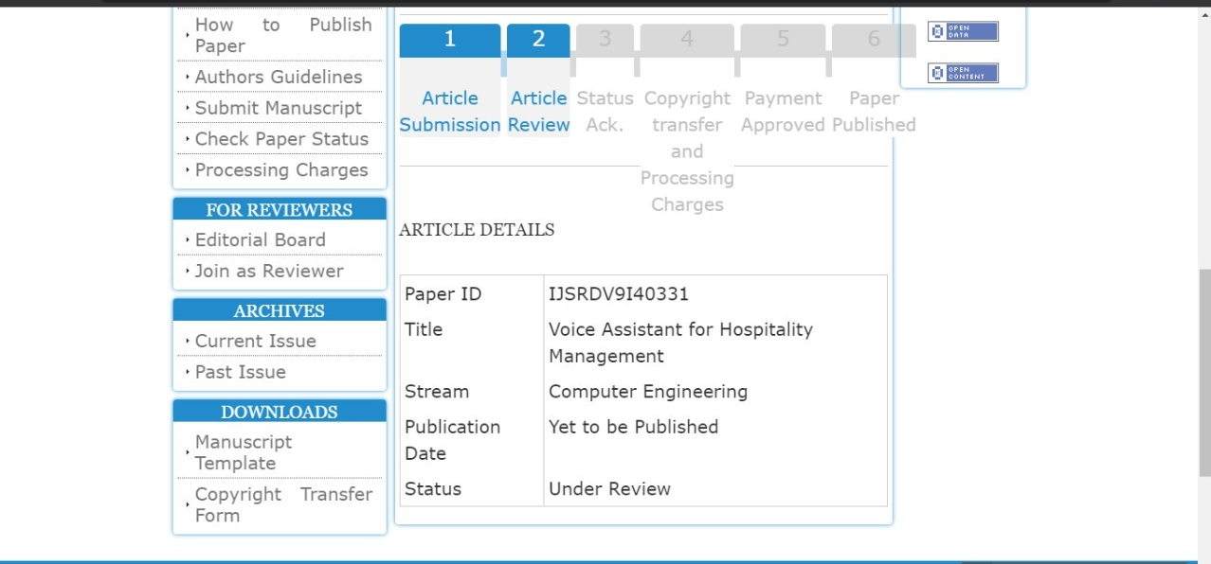
Paper Submission Status Phase-2
JSRD (International Journal of Scientific Research and Development) .

Slide 21
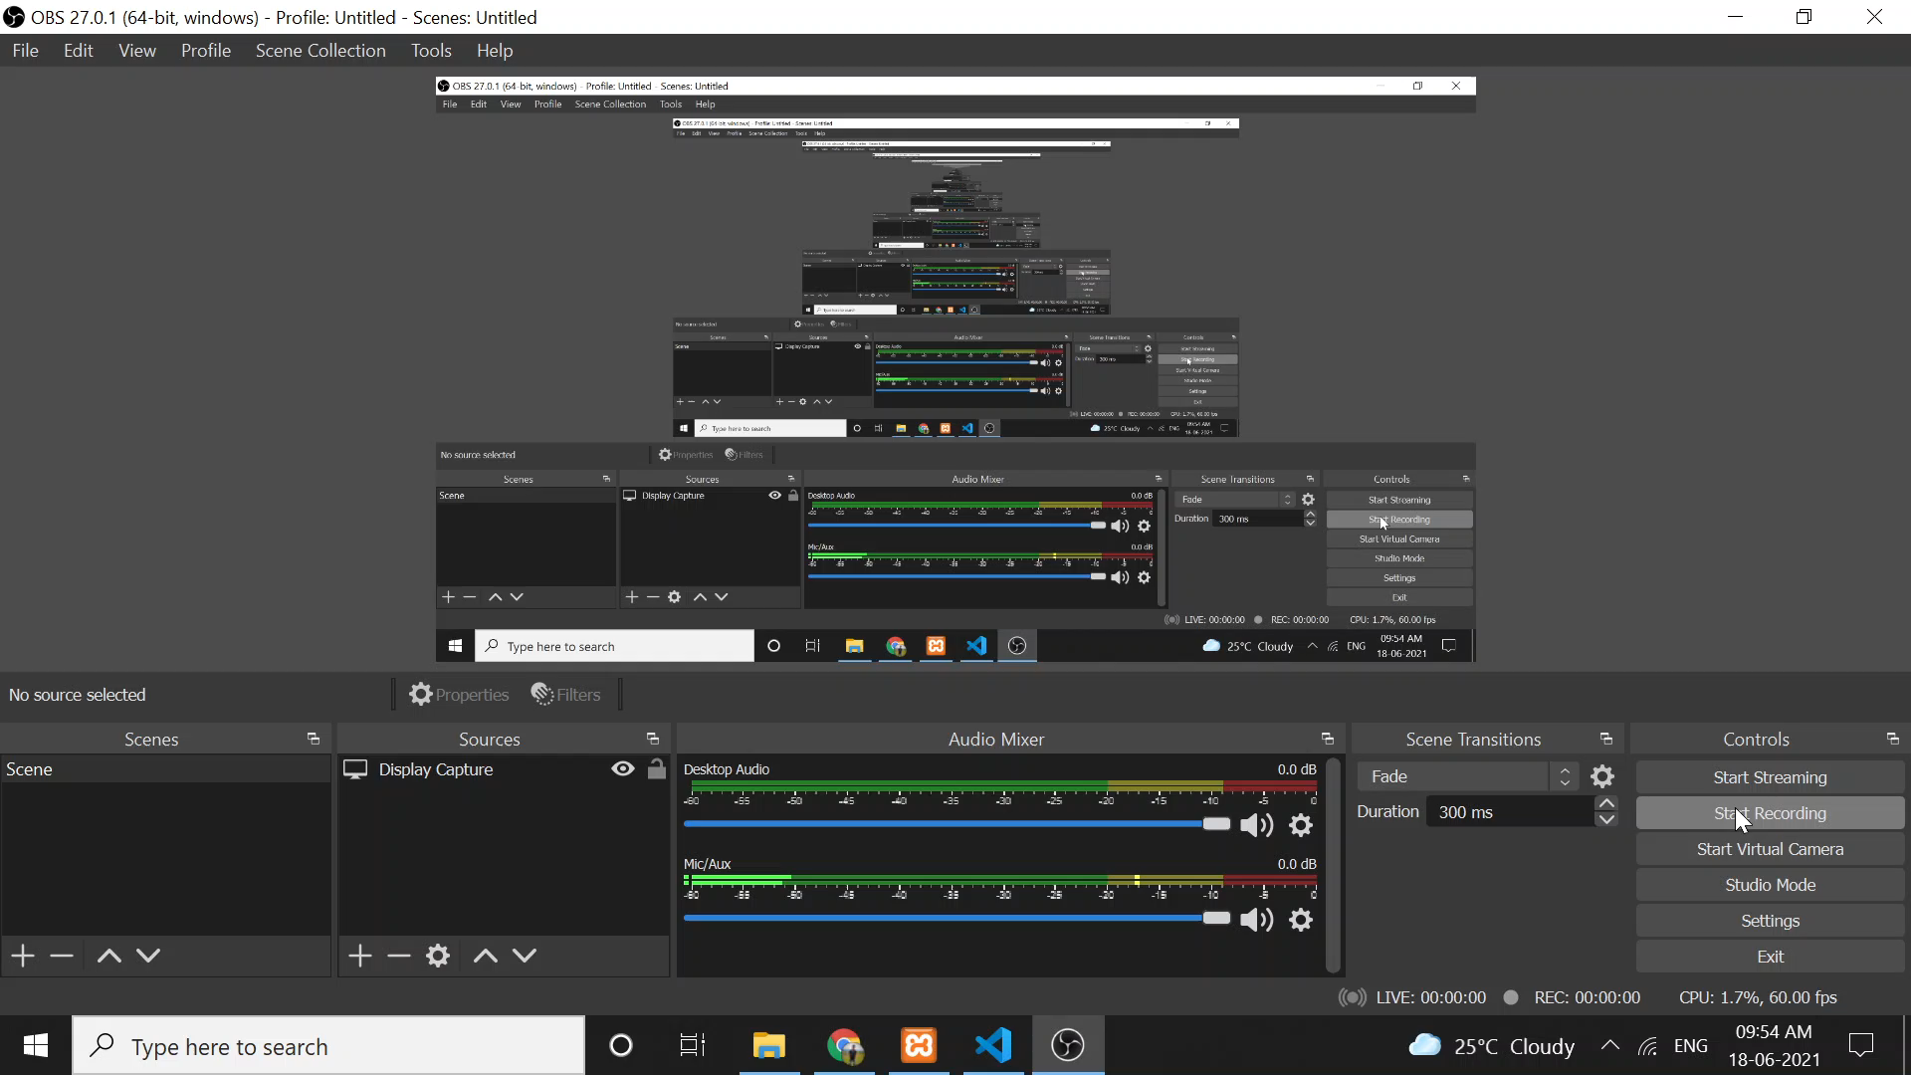
Implementation Video

Slide 22
THANK YOU!

